Slide 1




The Internet of Things
Presenter : Michael Koster (ARM)
Date : October 11th, 2014
Confidential. For registered class user only. Not for external distribution.

Slide 2
Reference Architecture
Web Browser, Smartphone App
Web App
http
Soft Endpoints
http/REST
Server
CoAP
IP Device
IP Device
BLE
BLE Device
APP
Android Device
HW Device Endpoints
Confidential. For registered class user only. Not for external distribution.

Slide 3
Protocol Layers and IoT Standards
Application Software
Application
IPSO Objects
Data Models
OMA LWM2M
API
CoAP
HTTP
Application Protocol
6LowPAN
IPV4/IPV6
Routing
802.15.4
WiFi, Ethernet
HW Network
MCU – 16KiB RAM
MPU
Hardware
Confidential. For registered class user only. Not for external distribution.

Slide 4
Protocol Layers Work Together
IPSO Smart Objects are based on OMA LWM2M
Defines application objects composed of resources using the LWM2M Object Model
Complex objects can be composed from simple objects
Easy to add new resource and object types as needed
OMA LWM2M is based on CoAP
Provides a server profile for IoT middleware
Defines a simple reusable object model
Defines management objects and reuses REST API for onboarding and device life cycle management
CoAP and related standards from IETF
CoAP Protocol (RFC 7252) provides a REST API for device abstraction and data compatibility layer for constrained networks and devices
HTTP Proxy provides application abstraction through standard web APIs
Core-link-format (RFC 6690) provides a way to add semantic descriptors in the form of web links and enables local resource discovery through the REST API
Resource Directory provides an API for scalable discovery and linking using core-link-format primitives
Confidential. For registered class user only. Not for external distribution.

Slide 5
Internet of Things
CoAP Protocol
Confidential. For registered class user only. Not for external distribution.

Slide 6
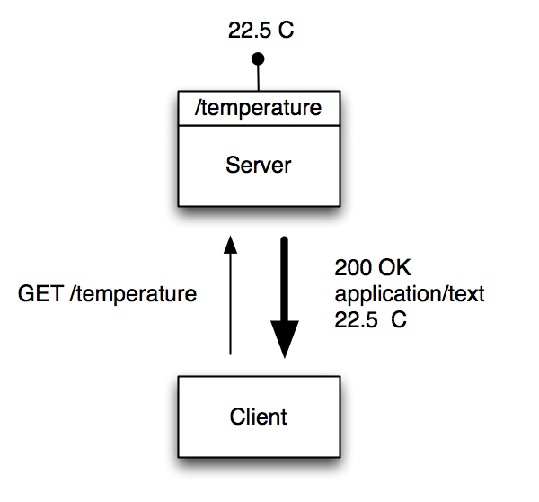
CoAP is REST for Constrained Devices
Makes each device a lightweight server that exposes a REST API
A CoAP device can be both client and server
Roles can be reversed and the sensor, as a client, can update a REST API at another node, device or server
Confidential. For registered class user only. Not for external distribution.

Slide 7
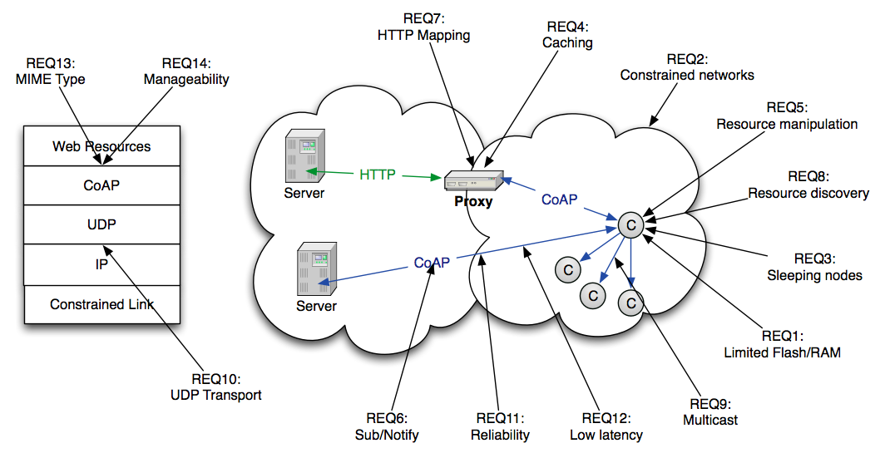
CoAP Use Case Requirements
REST API
Less Constrained
Resource Constrained
Confidential. For registered class user only. Not for external distribution.

Slide 8
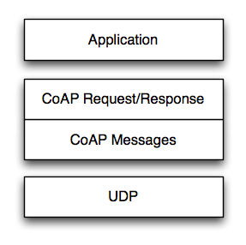
Transport Model
Transport
CoAP currently defines:
UDP binding with DTLS security
CoAP over SMS or TCP possible
Base Messaging
Simple message exchange between endpoints
Confirmable or Non-Confirmable Message
Answered by Acknowledgement or Reset Message
REST Semantics
REST Request/Response mapped onto CoAP Messages
Method, Response Code and Options (URI, content-type etc.) define REST exchanges, very similar to HTTP (HTTP 404 response semantics (not found) mapped to CoAP 4.04 response code)
Asynchronous Notifications
Observer option for GET allows asynchronous state update responses from a single request
Confidential. For registered class user only. Not for external distribution.

Slide 9
CoAP Header – Binary Protocol Mapping
Confidential. For registered class user only. Not for external distribution.

Slide 10
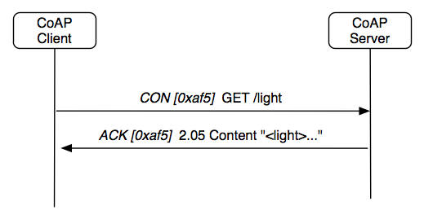
CoAP Request - Response
Confirmable Request
Response with Data Payload
Confidential. For registered class user only. Not for external distribution.

Slide 11
CoAP Caching
CoAP includes a simple caching model
Cacheability determined by response code
An option number mask determines if it is a cache key
Resource Discovery returns links to cache/proxy
Freshness model
Max-Age option indicates cache lifetime
Validation model
Validity checked using the Etag Option
A proxy often supports caching
Usually on behalf of a constrained node,
a sleeping node, a node behind a firewall,
or to reduce network load and battery drain
Confidential. For registered class user only. Not for external distribution.

Slide 12
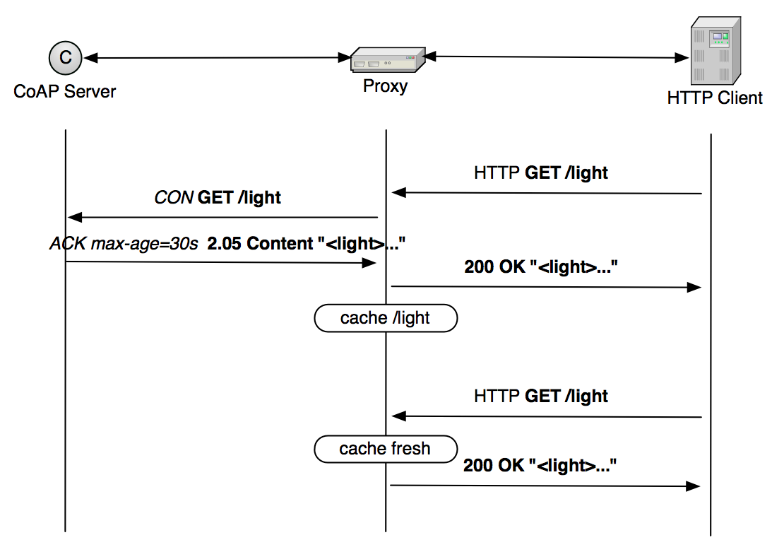
CoAP Proxy Caching
Confidential. For registered class user only. Not for external distribution.

Slide 13
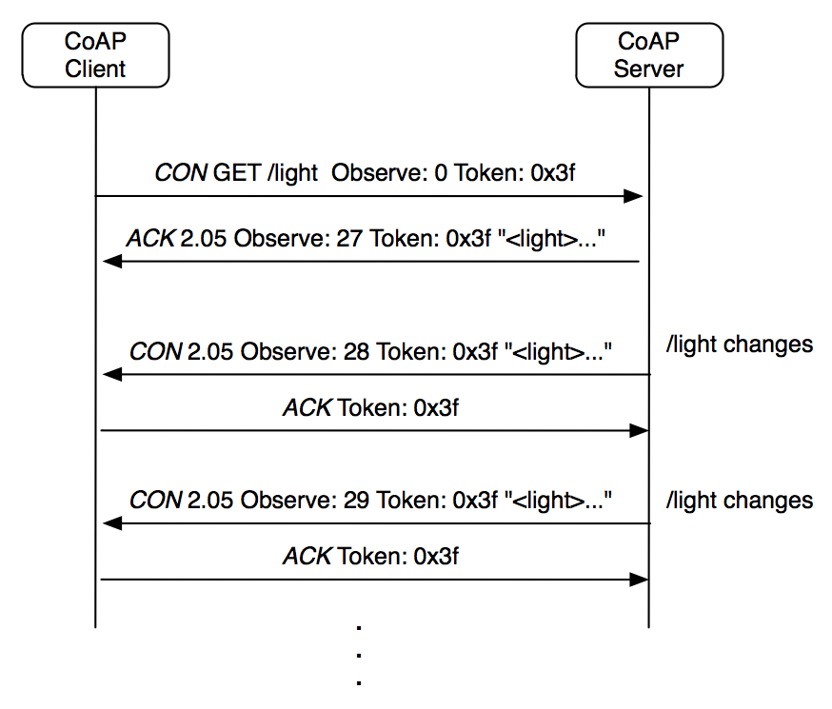
CoAP Observe – Asynchronous Notification
See draft-ietf-core-observe
Confidential. For registered class user only. Not for external distribution.

Slide 14
Internet of Things
CoAP Semantic Links & Discovery
Confidential. For registered class user only. Not for external distribution.

Slide 15
Discovery
Service Discovery
What services are available in the first place?
Goal of finding the IP address, port and protocol
Can be performed by e.g. DNS-SD when DNS is available
CoAP Services can be discovered using Resource Discovery
Resource Discovery
What are the Web resources I am interested in?
Goal of finding URLs to link into applications
Performed using Web Linking and REST API
CoRE Link Format is designed to enable resource discovery
Confidential. For registered class user only. Not for external distribution.

Slide 16
Web Linking for Machines
RFC6690 is aimed at Resource Discovery for M2M
Defines semantic link serialization and content-types suitable for M2M
Defines a well-known resource where links are stored
Enables query string parameters for discovery by attribute and relation
Can be used with unicast or multicast (CoAP)
Resource Discovery with RFC6690
Discovering the links hosted by CoAP (or HTTP) servers
GET /.well-known/core?optional_query_string
Returns a link-format document
URL, resource type, interface type, content-type, size are some basic relations
Confidential. For registered class user only. Not for external distribution.

Slide 17
Local Network Discovery
CoAP Client
CoAP Server
Could use multicast
DISCOVERY
GET /.well-known/core
2.05 Content
Could return a link-format document:
</3//9>;obs;rt=“urn:X-ipso:batt-level”;ct=”50”,
</3//0>;rt=”urn:X-ipso:dev-mdl”;ct=”50”,
</3//1>;rt=”urn:X-ipso:dev-mfg”;ct=”50”,
</3305/0/5800>;obs;rt=”urn:X-ipso:pwr-w”;ct=”50”,
</3305/0/5805>;obs;rt=”urn:X-ipso:pwr-accum-wh”;ct=”50”,
</3303/0/5700>;obs;rt=”urn:X-ipso:temp-C”;ct=”50”
Confidential. For registered class user only. Not for external distribution.

Slide 18
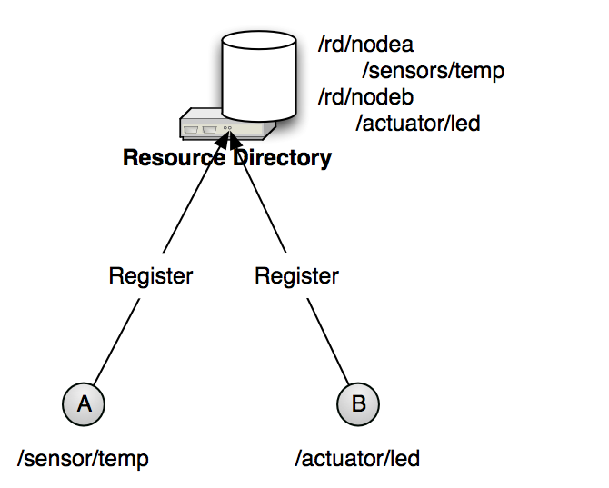
Resource Directory Discovery
CoRE Link Format defines
The link format
Peer-to-peer discovery
A directory approach is also useful
Supports sleeping nodes
No multicast traffic, longer battery life
Remote lookup, hierarchical and federated distribution
CoRE Link Format is used in Resource Directories
Nodes POST (register) their link-format to an RD
Nodes PUT (refresh) to the RD periodically
Nodes may POST to add links to the RD
Nodes may DELETE (remove) their RD entry
Nodes may GET (lookup) the resources of other nodes
Web Applications Discover
Registered Resources
See draft-ietf-core-resource-directory
Confidential. For registered class user only. Not for external distribution.

Slide 19
Resource Directory
Endpoint
Endpoint
core.rd service
REGISTRATION
POST /rd?ep=‘235598376’&lt=19999
</3303/0/5700>;rt=“urn:X-ipso:temp-C”
2.01 Created Location:/rd/235598376
DISCOVERY
GET /rd-lookup?ep&rt=“urn:X-ipso:temp-C”
2.05 Content
</235598376/3303/0/5700>;rt=“urn:X-ipso:temp-C”
See draft-ietf-core-resource-directory
Confidential. For registered class user only. Not for external distribution.

Slide 20
Internet of Things
OMA LWM2M
Confidential. For registered class user only. Not for external distribution.

Slide 21
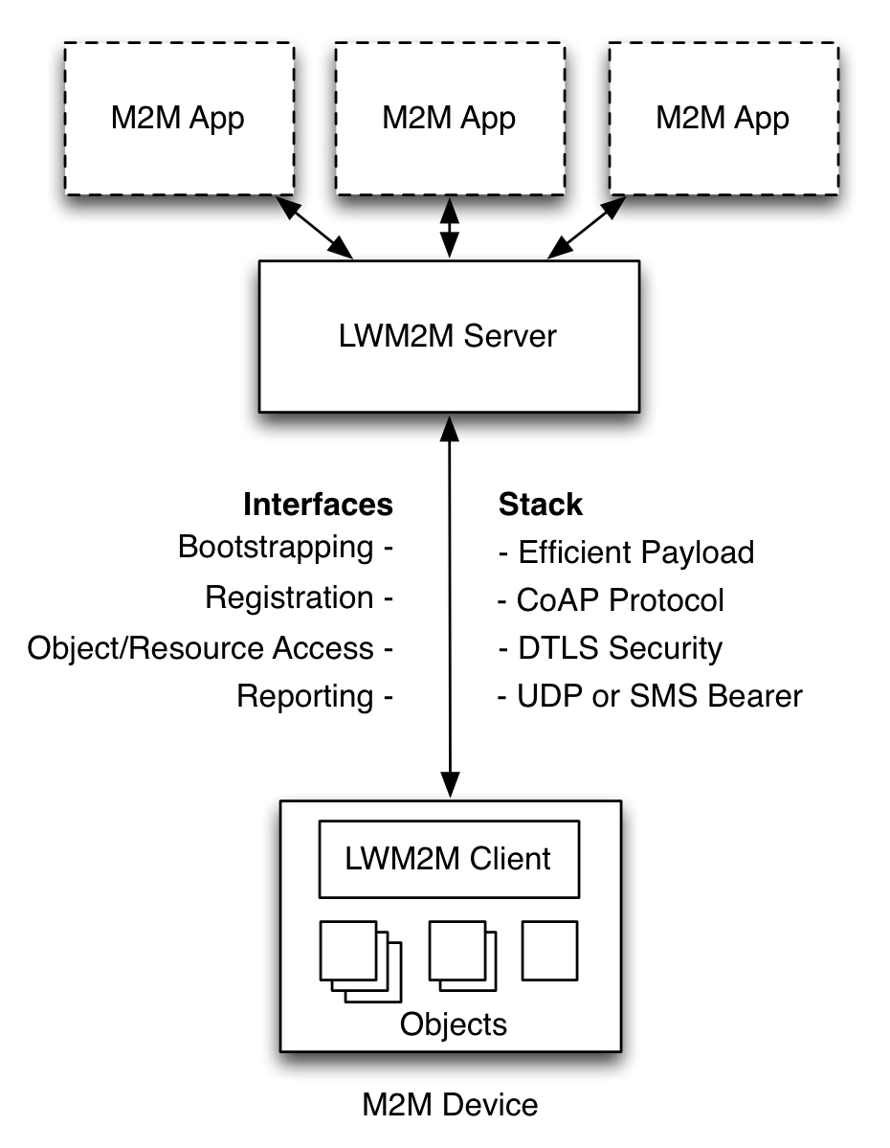
LWM2M Architecture
Web Applications
Application abstraction through REST API
Resource Discovery and Linking
LWM2M Server
CoAP
HTTP Caching Proxy
Resource Directory
Gateway and Cloud deployable
LWM2M Clients are Devices
Device abstraction through CoAP
LWM2M Clients can be CoAP Servers
Any IP network connection
Confidential. For registered class user only. Not for external distribution.

Slide 22
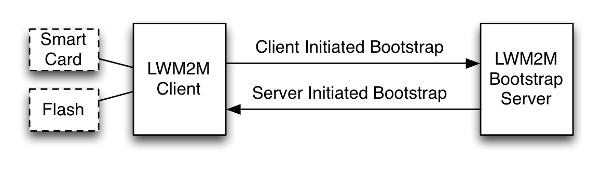
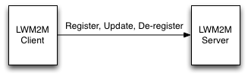
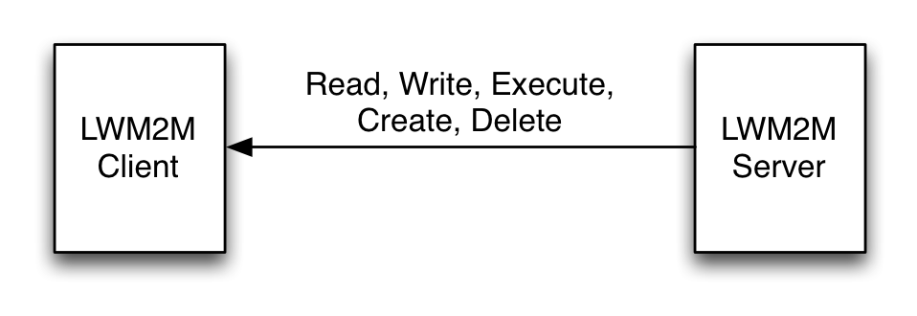
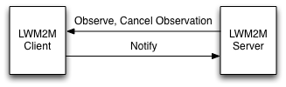
LWM2M Interfaces
Bootstrap Interface
Configure Servers & Keying
Pre-Configure, Smart Card, Server Initiated Bootstrap
Registration Interface
RFC6690 and Resource Directory
Management Interface Using Objects
Management Objects and Resources
Uses the CoAP REST API
Reporting Interface
Subscription to Object Instances and Resources
Asynchronous notification using CoAP
Confidential. For registered class user only. Not for external distribution.

Slide 23
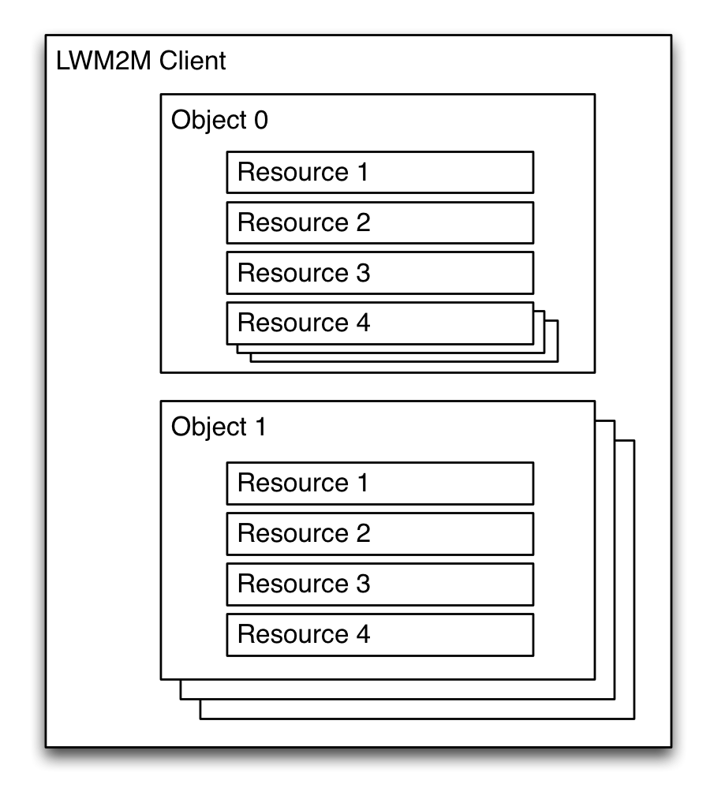
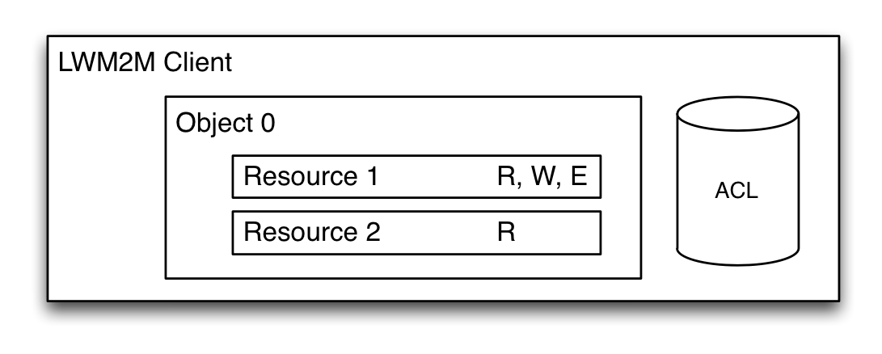
LWM2M Object Model
A Client has one or more Object Instances
An Object is a collection of Resources
A Resource is an atomic piece of information that can be
Read, Written or Executed
Resources can have multiple instances
Objects and Resources are identified by a 16-bit Integer, Instances by an 8-bit Integer
Objects/Resources are accessed with simple URIs:
/{Object ID}/{Object Instance}/{Resource ID}
Ex: /3/0/1 (Object Type=Device, Instance=0, Resource=Device Mfg.)
Confidential. For registered class user only. Not for external distribution.

Slide 24
LWM2M Management Objects
Confidential. For registered class user only. Not for external distribution.

Slide 25
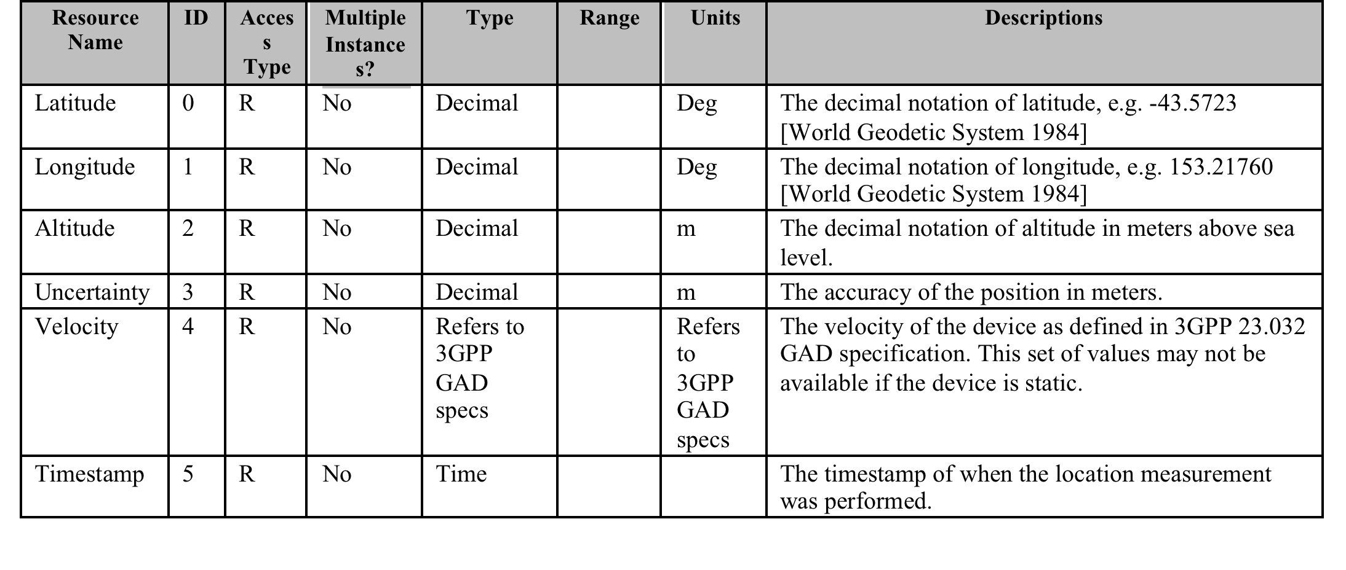
Example Object – Position Object
Confidential. For registered class user only. Not for external distribution.

Slide 26
Internet of Things
IPSO Smart Objects
Confidential. For registered class user only. Not for external distribution.

Slide 27
IPSO Alliance
IPSO Alliance - semiconductor, device, and system manufacturers
Smart Object Committee meets every 2 weeks, recently completed the Smart Objects 1.0 IPSO Technical Guideline
Uses the OMA LWM2M Object Model to define application objects
Resource IDs and Object IDs are registered with the OMNA
Provides a framework for Application Level Interoperability
Builds common definitions of web objects for use with standard web protocols (CoAP, HTTP)
Defines reusable resources and objects that map to physical sensors, actuators, objects
Confidential. For registered class user only. Not for external distribution.

Slide 28
IPSO Smart Objects
IPSO Smart Objects provide a common data model across different sensor types, enabling application level interoperability
Interoperability between end devices and applications
Allows decoupling of devices from dedicated application services
Repurposing and multi-purposing of devices, reusability of application software
Interoperability across platforms and M2M protocols
Enables developers of embedded device and web services to focus on the value endpoints
Confidential. For registered class user only. Not for external distribution.

Slide 29
IPSO Smart Object
Common representations and units
Refers to well-known namespaces like ucum
Default units e.g. Celsius, kPa
Object, object instances, and resource instances are addressable using paths constructed from object and resource type IDs
Example: GET /sensors/3303/0/5700
Returns a representation of the current value of the ‘5700’ resource (Current Value) from instance ‘0’ of Object Type ‘3303’ (Temperature)
Confidential. For registered class user only. Not for external distribution.

Slide 30
Example Smart Object - Temperature
Object with
Internal
resources
Confidential. For registered class user only. Not for external distribution.

Slide 31
Object Annotation
Object annotation (not part of LWM2M Standard) uses core-link-format metadata for semantic description
Described in IETF CoRE Interfaces document (http://datatracker.ietf.org/doc/draft-ietf-core-interfaces) enables GET by relation and attribute
For example, GET /rd-lookup?ep&rt=“urn:X-ipso:temp-C”
Returns: </sensors/3303/0/5700>;obs;if=“urn:X-ipso:sensor”;rt=“urn:X-ipso:temp-C”;ct=50;u=“ucum:degC”
Refers to qualified, resolvable namespaces and concepts
Supports CoRE Resource Discovery
Confidential. For registered class user only. Not for external distribution.

Slide 32
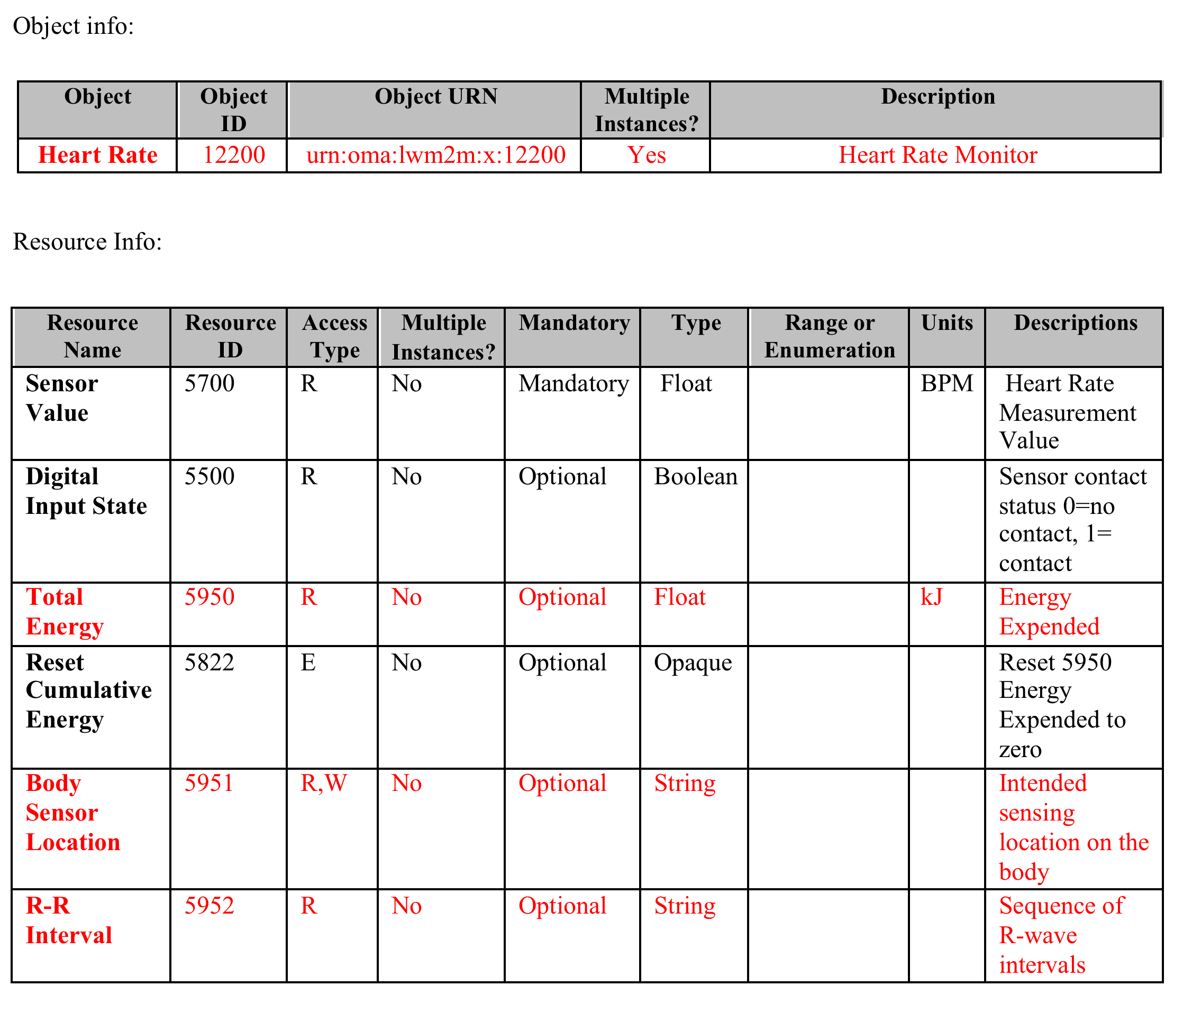
Example Smart Obejct Ad-Hoc binding
Confidential. For registered class user only. Not for external distribution.

Slide 33
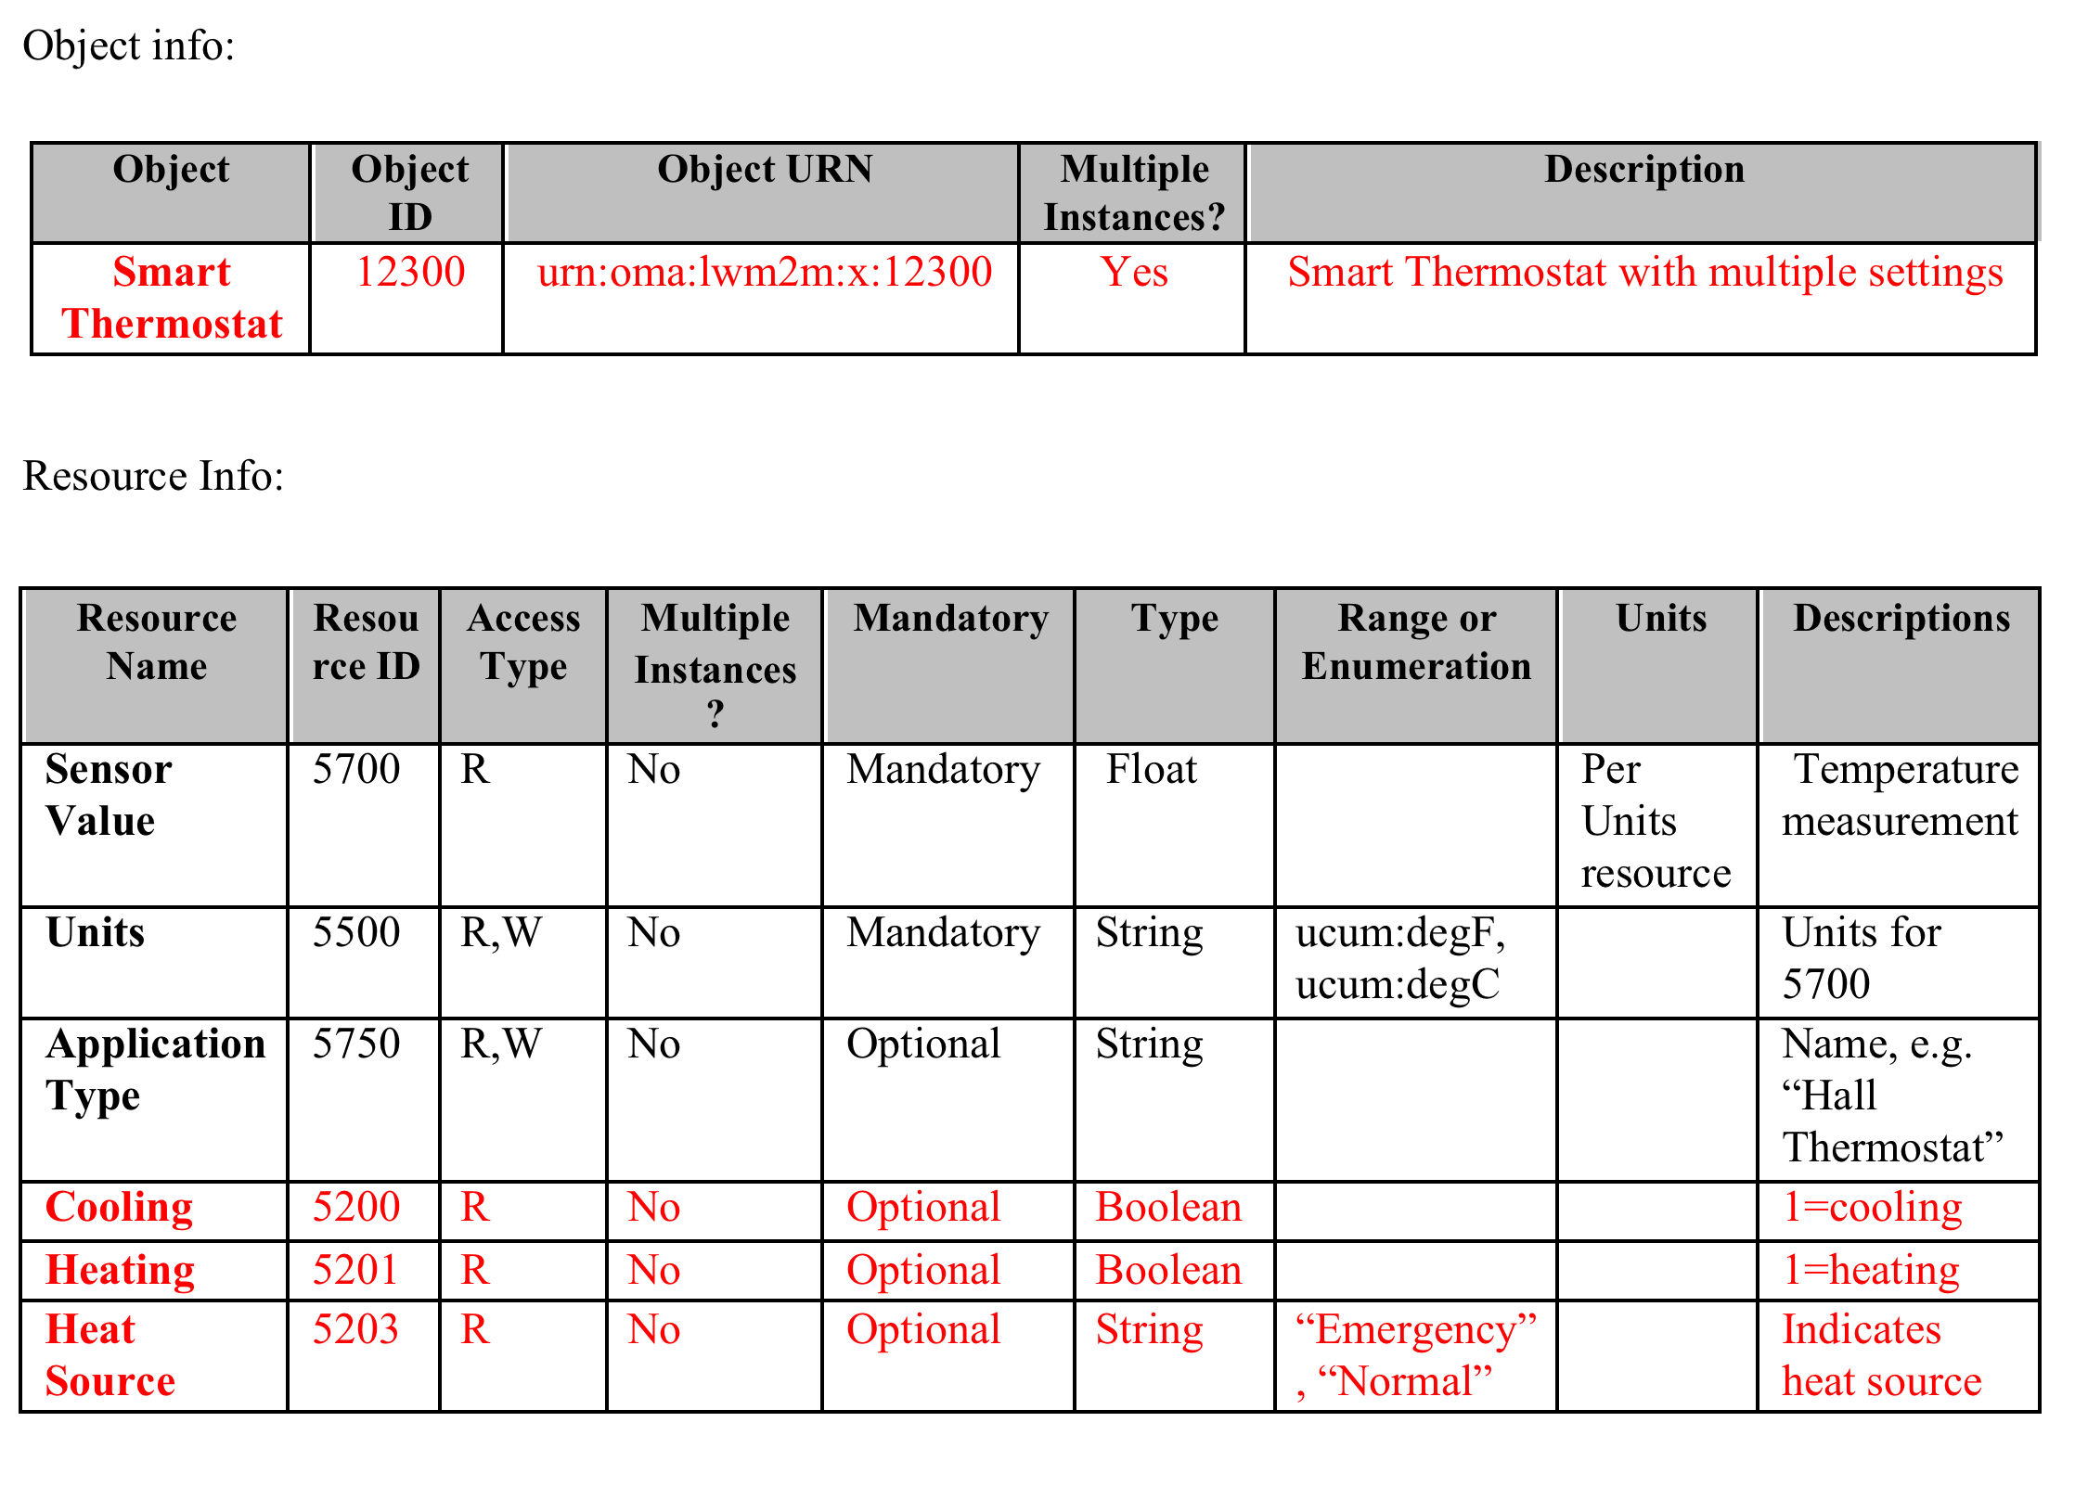
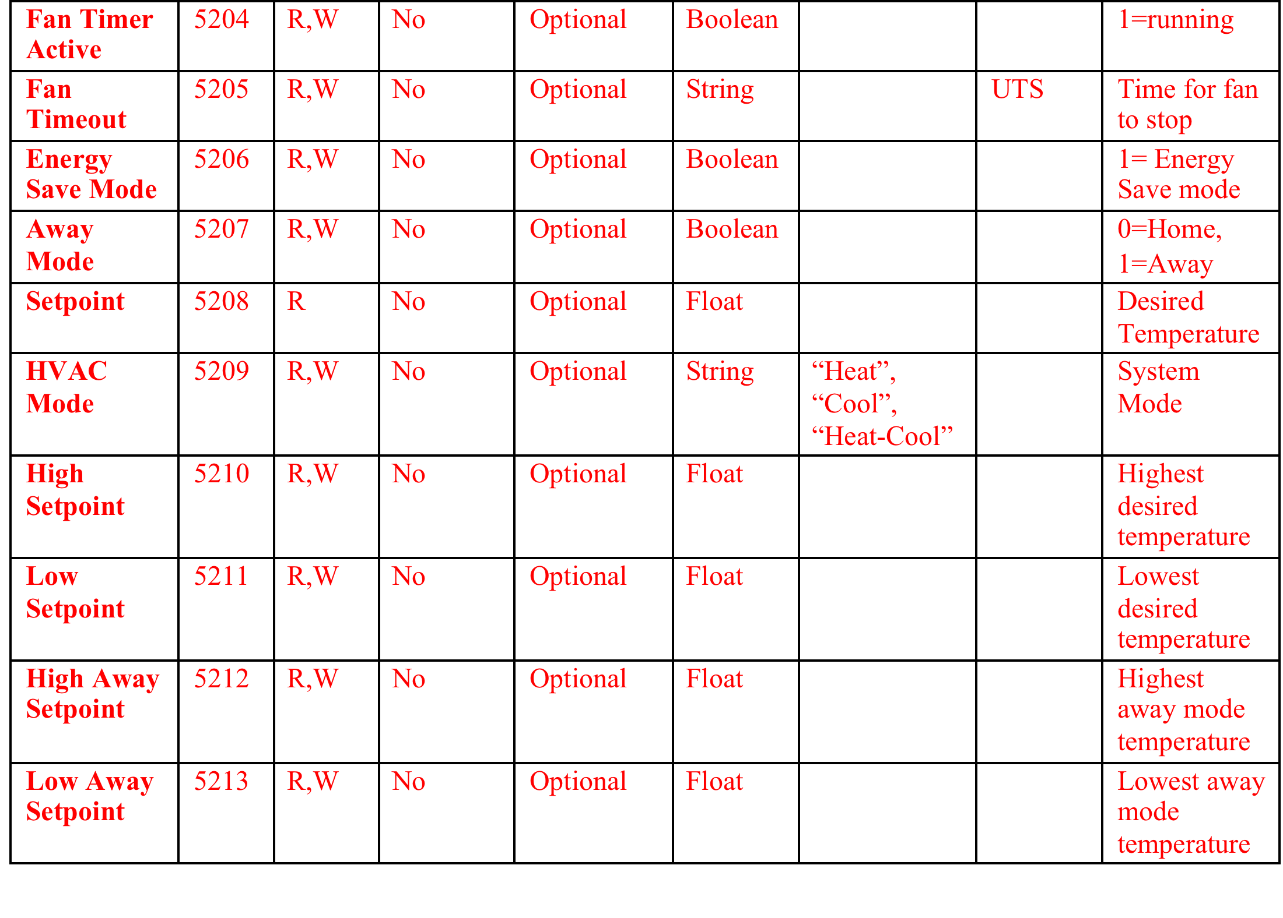
Binding to Smart Thermostat
Confidential. For registered class user only. Not for external distribution.

Slide 34
Smart Object Summary
Simple web objects that represent common sensors, actuators, and data elements exposed for Internet of Things applications
Based on Internet and Industry Standards
Objects can be composed into more complex objects; for example a temperature object, set point object, and load control object can be combined to create a thermostat object
About to publish the first set of objects to cover some common Smart Home and Sensor use cases
New objects are easy to create; we are planning a developer-friendly process for creating and registering new objects
Confidential. For registered class user only. Not for external distribution.

Slide 35
Layered Standards
Application Software
Not tied to specific device or protocol
Any Programming Language
Runs on devices, gateways, and services
Application Level Interoperability
Reusable Device to Application API
Not tied to any specific protocol
IPSO Smart Objects
Service Layer Specification
Device Management over CoAP
Object Model for DM and Applications
OMA LWM2M
REST protocol for constrained devices
IETF Standard (RFC 7252)
Uses TCP or UDP, any IP connection
Discovery using IP Multicast or Directory
CoAP
Confidential. For registered class user only. Not for external distribution.

Slide 36
Standards References
IPSO Smart Object Guideline
http://www.ipso-alliance.org/technical-information/ipso-guidelines
OMA LWM2M Specification
http://openmobilealliance.hs-sites.com/lightweight-m2m-specification-from-oma
IETF CoAP and Related Specifications
CoAP (RFC 7252):
http://tools.ietf.org/html/rfc7252
CoRE Link-Format (RFC 6690):
http://tools.ietf.org/html/rfc6690
CoRE Resource Directory: http://tools.ietf.org/html/draft-ietf-core-resource-directory-01
CoAP Community Site
http://coap.technology/
Confidential. For registered class user only. Not for external distribution.

Slide 37
Internet of Things
ARM mbed
Confidential. For registered class user only. Not for external distribution.

Slide 38
mbed Mapping to Reference Architecture
Web Browser, Smartphone App
Web App
http
Soft Endpoints
http/REST
mbed
Device Server
CoAP
mbed OS
IP Device
IP Device
BLE
BLE Device
APP
Android Device
HW Device Endpoints
mbed Java Client
Confidential. For registered class user only. Not for external distribution.

Slide 39
Registration
Web Browser, Smartphone App
Web App
http
Soft Endpoints
http/REST
mbed
Device Server
CoAP
REGISTER
REGISTER
REGISTER
mbed OS
IP Device
IP Device
BLE
BLE Device
APP
Android Device
HW Device Endpoints
mbed Java Client
Confidential. For registered class user only. Not for external distribution.

Slide 40
Discovery
Web Browser, Smartphone App
Web App
http
Soft Endpoints
DISCOVER
DISCOVER
http/REST
DISCOVER
mbed
Device Server
CoAP
mbed OS
IP Device
IP Device
BLE
BLE Device
APP
Android Device
HW Device Endpoints
mbed Java Client
Confidential. For registered class user only. Not for external distribution.

Slide 41
Example Transaction
Web Browser, Smartphone App
Web App
http
Soft Endpoints
1. GET
http/REST
4. REPLY
mbed
Device Server
CoAP
3. REPLY
mbed OS
2. GET
IP Device
IP Device
BLE
BLE Device
APP
Android Device
HW Device Endpoints
mbed Java Client
Confidential. For registered class user only. Not for external distribution.

Slide 42
Asynchronous Notification
Web Browser, Smartphone App
Web App
http
Soft Endpoints
NOTIFY
http/REST
mbed
Device Server
CoAP
mbed OS
NOTIFY
IP Device
IP Device
BLE
BLE Device
APP
Android Device
HW Device Endpoints
mbed Java Client
Confidential. For registered class user only. Not for external distribution.

Slide 43
mbed Java Client in BLE-CoAP Proxy
Web Browser, Smartphone App
Web App
http
Soft Endpoints
REPLY
GET
http/REST
mbed
Device Server
CoAP
REPLY
mbed OS
GET
BLE
IP Device
REPLY
BLE Device
IP Device
APP
READ
Android Device
HW Device Endpoints
mbed Java Client
Confidential. For registered class user only. Not for external distribution.

Slide 44
Internet of Things
Projects
Confidential. For registered class user only. Not for external distribution.

Slide 45
Project Challenge
Build Use Cases for the connected Smart Home around Assisted Living
Implement a set of connected devices and software applications to solve problems based on use cases
Use mbed Device Server to connect applications to one or more of the connected devices
Find extra value in applications that use more than one device
Demonstrate your solution
Confidential. For registered class user only. Not for external distribution.

Slide 46
Technology
Technology Framework
Seeed Studio Arch Pro with ethernet connectivity, WiFi option using Arduino Shield
32KB RAM, 512KB Flash
Modular Sensors using Seeed Studio Grove System
mbed OS with LWM2M client endpoint libraries
mbed Device Server Cloud Instance
Confidential. For registered class user only. Not for external distribution.

Slide 47
Technology
Sensors
Seeed Studio Grove System
Sensors for Light, Sound, Motion, Temperature, Acceleration (gravity), Gas, Dust, Smoke, push button
Actuators – RGB LED, relay control, buzzer, LED display, Bar graph
Sensor List is in the materials
Sensor catalog is online at Seeed
Confidential. For registered class user only. Not for external distribution.

Slide 48
Alternative Platform
Bluetooth LE
Can be powered by coin cell
mbed project with BLE interface
Heart Rate Sensor Demo
Needs Android Device to connect
Android Project in Eclipse IDE
Need Android Developer Mode to install
Project involves 3 parts to connect to mDS
mbed device, Android device proxy, mDS
Confidential. For registered class user only. Not for external distribution.

Slide 49
Project Outline
Week 1
Introduction, platform demo, initial hardware setup, device to cloud connectivity, use case analysis, ideation, testing, project definition
Week 2
Project construction, protovation, device to application testing
Week 3
Integration with application code, cross team integration
Week 4
Fine tuning, demonstrations
Confidential. For registered class user only. Not for external distribution.

Slide 50
Demonstration
Connect Sensor to mbed Device Server cloud instance
Import hello mDS project for the mbed board
Compile the project for the Arch Pro
Drag and drop to program the board
Turn it off and on again to reset
Monitor the serial port debug messages
Verify the registration with mDS
Use a REST client to read the list of registered nodes
Confidential. For registered class user only. Not for external distribution.

Slide 51
Lab 1 – Connect to mbed Device Server
Connect your mbed board to mDS
Detailed instructions are in the lab notes
Get your mbed account
Import the hello mDS project
Compile and download to your mbed board
Power cycle to reset
Verify registration with the mbed Device Server
Read serial debug messages indicating success
Use the mDS admin interface to check
Use a REST client to read from mDS
Confidential. For registered class user only. Not for external distribution.

Slide 52
Links
https://mbed.org/
http://developer.mbed.org/platforms/Seeeduino-Arch-Pro/
http://developer.mbed.org/platforms/Nordic-nRF51822/
http://www.seeedstudio.com/
http://www.seeedstudio.com/wiki/Grove
http://cattavery.tumblr.com/post/99061408776/human-habitat-houses-assisted-living-devices-and-iot
Confidential. For registered class user only. Not for external distribution.

Slide 53
Thank You
Confidential. For registered class user only. Not for external distribution.

